Slide 1

Project 2
Matt Dunaway and Peter Truax

Slide 2
ETL Process
IMPORT FROM CSV FILE IN VISUAL STUDIO
CREATE NEW SSIS PACKAGE
CREATE FLAT FILE CONNECTION MANAGER
CREATE OLE DB DESTINATION CONNECTOR

Slide 3
Extract-Gathering Data
Got historical prices .csv of 5 large retailers from 12/01/1999-01/31/2022 from http://finance.yahoo.com/q/hp?s=YHOO.

Slide 4
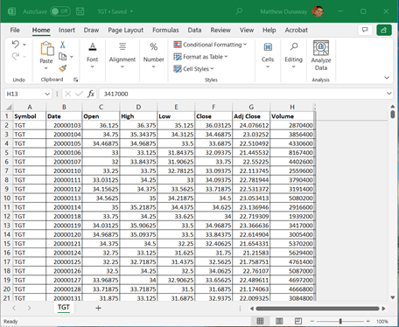
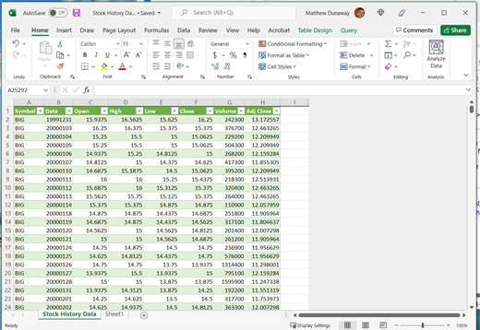
Transform- CSV Flat File Data-date format
Formatted the .csv data to have the stock name in the first column and replicated the stock name using Ctrl-D on the empty cells in the entire column and the date to YYYYMMDD using Right-Click selected cells->Format Cell->Date->Custom-> Enter ”YYYYMMDD” in the text box and select OK.

Slide 5
SSIs
Created a new database in SSMS called StockHistoryData and created a new table with the data types (int32, double, date) for each column.
01
Created a new integration project in Visual Studio and used Connection Manager to create a new Flat File Connection. In the Data Flow tab, I connected the Flat File Connection (csv) input to OLEDB (StockHistoryData) output.
02
I started the execution and it returned no errors. I returned to SSMS and queried the database to ensure success.
03

Slide 6
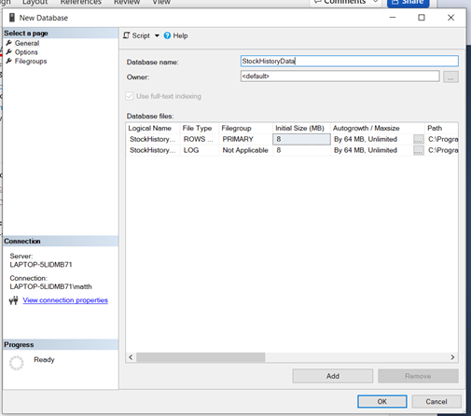
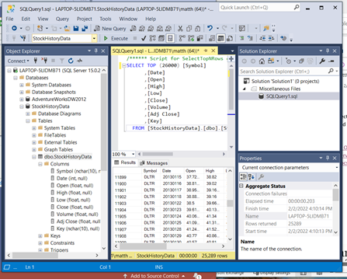
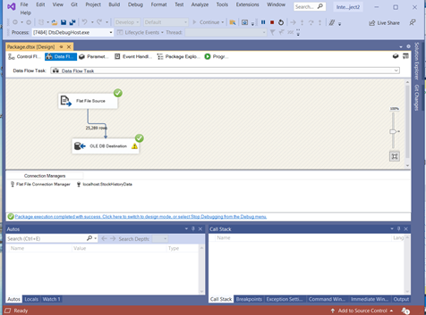
SSIS Data flow
These are showing the screens for matching data types and what the flat file connection manager looks like.

Slide 7
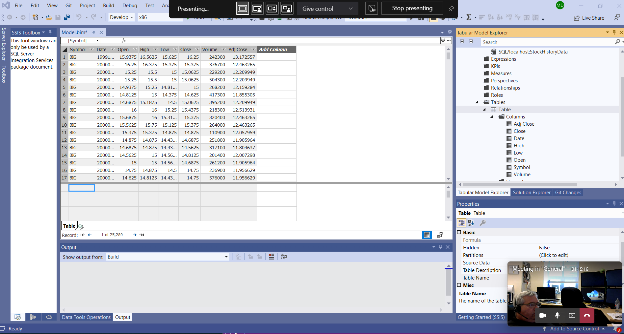
SSAs
We went back to Visual Studio and started a new Analysis Services project and loaded the extracted and transformed StockHistoryData csv. We successfully loaded the data to a single tabular format. Unfortunately, we weren't able to run our analysis, despite hours of work. We used Power BI instead.

Slide 8
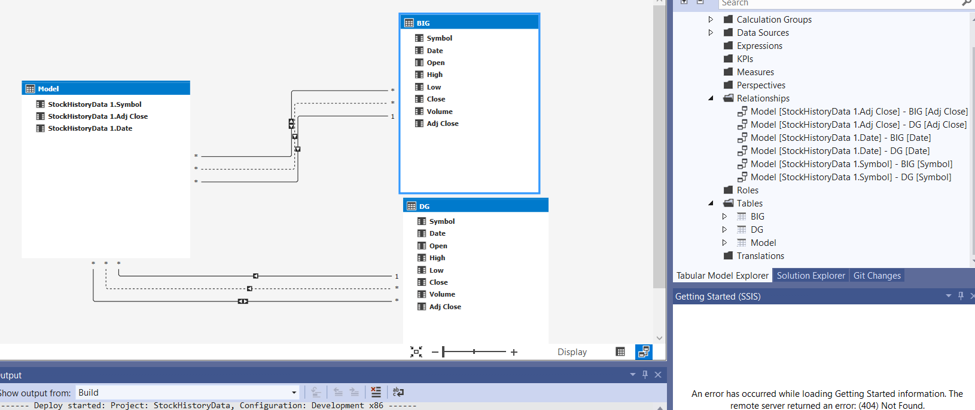
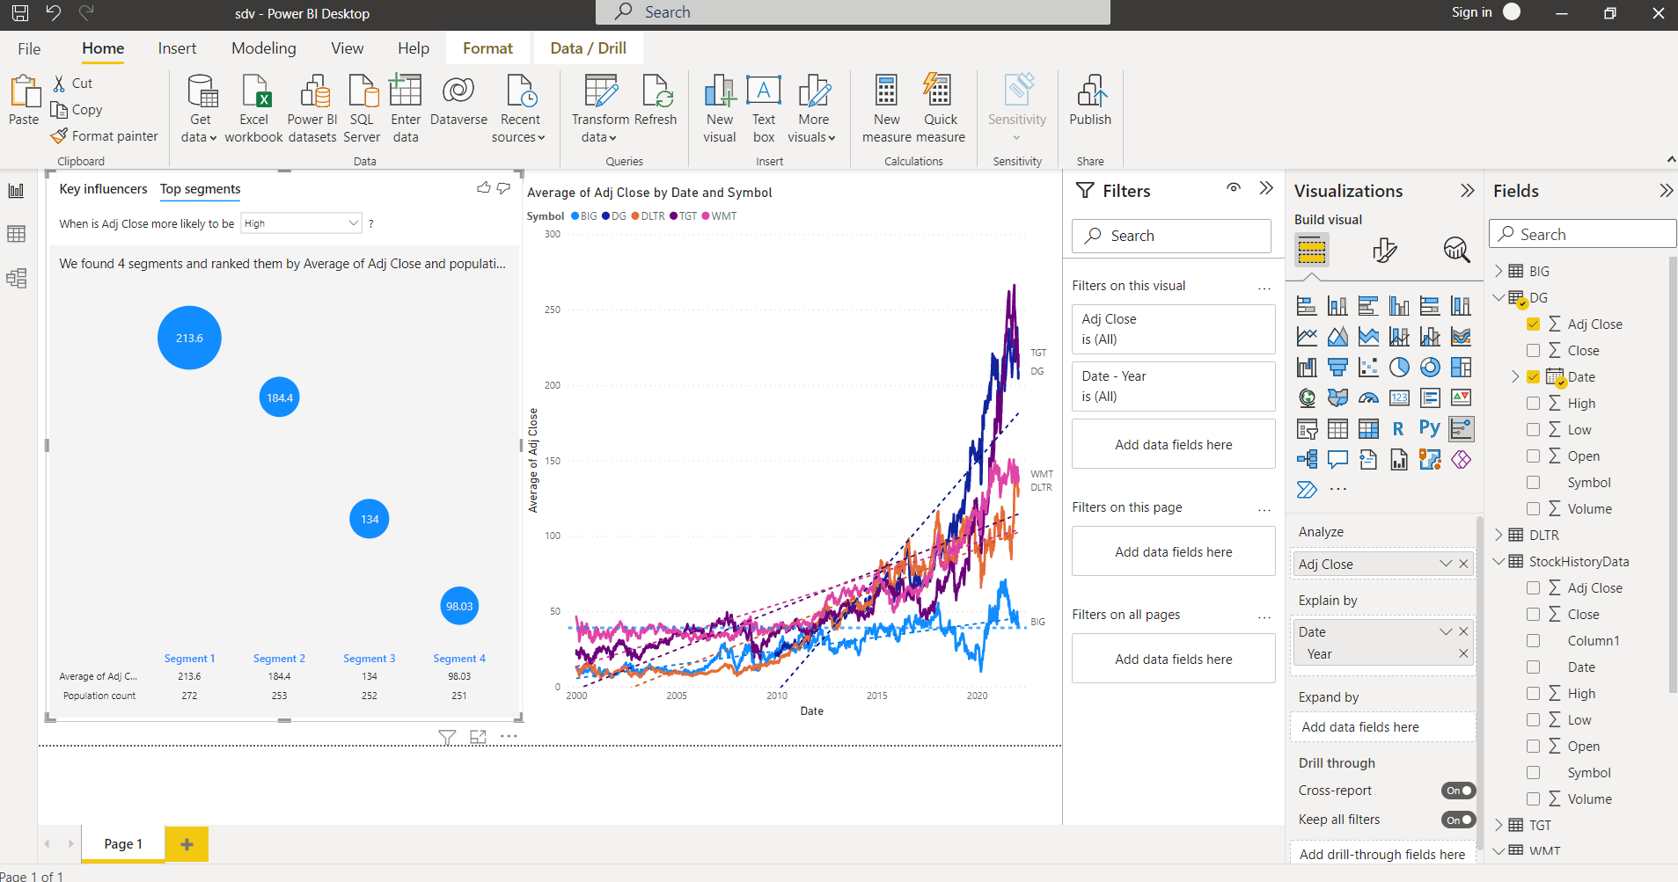
Analysis
We ran analysis for Dollar General in Power BI and found that the adjusted close price increased by 53 points a year. The largest increase of stock price was after 2020 according to population grouping. We also plotted difference in total adjusted close price and found Dollar General has increased their stock price by 1100% since 12/01/2009!!!

Slide 9

Conclusion-LESSONS LEARNED
The ETL process can be performed all at once or one step performed repeatedly, depending on what program you are using. Also, these steps can be performed out of order.
Different versions of SQL Server (2018/2019/2022) allow for different levels of compatibility (1200/1500) with other programs such as Visual Studios.
Pay attention to whether you selected Analysis Services or Multidimensional Services when you are setting SQL Server up.
The ISO 8601 date format may be useful in theory, but Excel will change it to a number format. Your graphs will show exponents for the x-axis in Power BI, SPSS, and R Studio. Aka watch what format your date column is transformed into.

